Slide 1


FOOTBALL LEAGUE DATABASE SYSTEM
DBMS PROJECT
DONE BY:
G. RAM CHARAN TEJ , 21CSB0B17
T. JAYANTH VINNY , 21CSB0B57

Slide 2
PROBLEM STATEMENT:
The game football is loved by huge population all over the world. It is useful to have a football database system about a league so that people who follow it can have easier access to statistics related to it.
The project would allow us to know the statistics of a player, team and also support functions like adding, modifying and removing team and player details, tracking team performance, recording match information, calculating match results and league rankings , etc.

Slide 3
CONTENT:
E – R MODEL
ASSUMPTIONS
RELATIONAL SCHEMA
NORMALIZED TABLES AND INPUTS
QUERIES WITH OUTPUTS

Slide 4
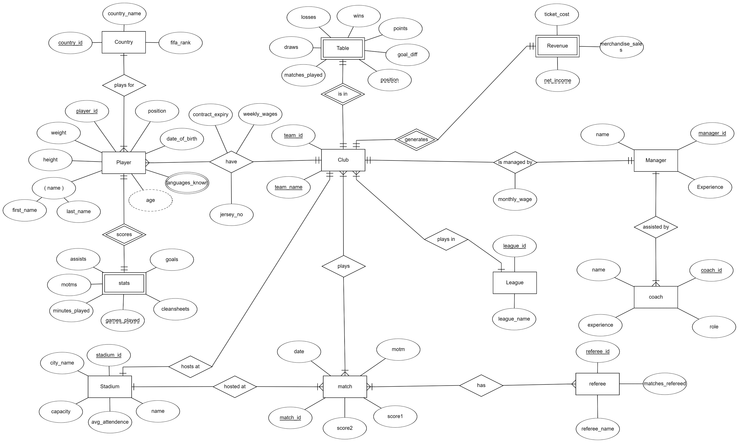












ENTITY – RELATIONSHIP DIAGRAM :

Slide 5
ASSUMPTIONS:
We have assumed that there are only 5 teams in a league.
We have assumed the management of a single football league, rather than multiple football leagues simultaneously.
We have assumed only basic information like match results, goals, assists, etc. and excluded information like yellow/red cards, suspensions, etc.
We have only included data regarding current players, events and excluded historical data.
We have focussed information mostly on player and team management rather than financial or ownership details.
We have assumed that no transfers can happen between teams for players.
We have considered only simple leagues which have simple round-robin structure and table leader as winner rather than complex structure involving divisions, groups, playoffs or knockout stages which have been neglected.
The data entered is through manual insertions so real-time updates are not possible.
We have assumed that players are only from 5 different countries.

Slide 6
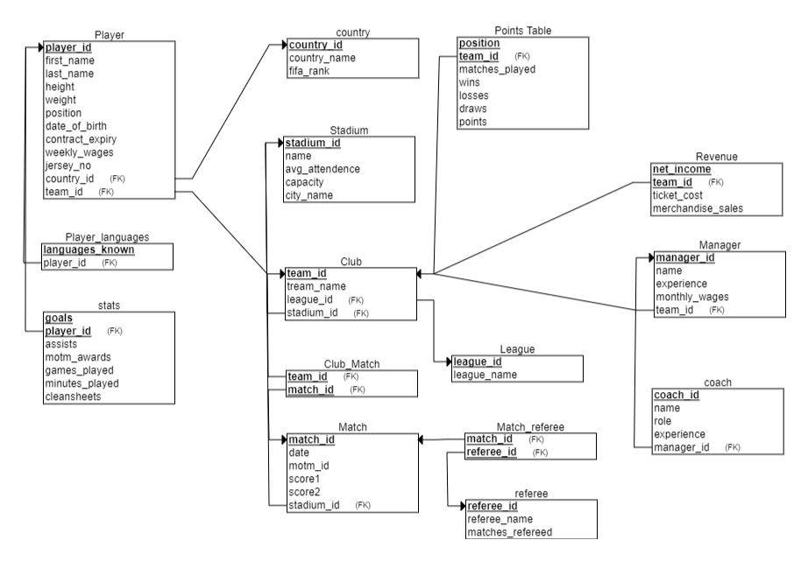

RELATIONAL SCHEMA:

Slide 7
ENTITIES :
Player :
player entity holds information about players in the league
This entity has player_id, first_name, last_name, height, weight, position, date_of_birth, contract_expiry, weekly_wages, jersey_no, country_id, team_id as attributes.
This entity has player_id as primary key.
This entity has country_id, team_id as foreign keys.

Slide 8
Club:
This entity holds information related to the team.
It has team_id, team_name, league_id, stadium_id as attributes.
This entity has team_id as primary key.
It has league_id and stadium_id as foreign keys.
It has one-many relationship with league entity and one-one relationship with stadium entity.
Country:
This entity holds information related to the country.
It has country_id, country_name and fifa_rank as attributes.
It has country_id as foreign key.

Slide 9
Stadium:
This entity holds information regarding the stadium.
This entity holds stadium_id, avg_attendance,stadium_name,stadium_capacity as attributes
This entity has stadium_id as primary key.
League:
This entity holds information about the league being played.
It has league_id as primary_key.
It has league_id,league_name as attributes.

Slide 10
Points_table:
This entity is used to determine the position of a team in table and ultimately the winner.
It has team_id, wins, losses, draws, points, matches_played as attributes
It has team_id as foreign key.
Manager_table:
It describes the manager of the club.
This entity has managerid,team_id, manager_name, experience, monthly_wages, etc.
It has team_id as foreign key.

Slide 11
Coach:
This entity tells about the coaches work under a certain manager.
It has coach_id, manager_id, coach_name, happy.
It has manager_id as foreign key.
Revenue:
This entity tells out revenue gained by a club , through ticket sales,and merchandise_sale.
It has revenue as net_income, team_id, ticket_cost and merchandise sales as attributes.

Slide 12
Referee:
This entity gives the information about referees.
This entity has referee_id, referee_name and matches_refereed as attributes.
This entity has referee_id as primary key.
Club- Match:
This entity tells about which club played which match.
It has club_id,match_id combined as primary key.
It has both club_id, match_id as foreign keys.

Slide 13
Stats:
It tells about the performance of a player.
It has goals, assists, player_id, motms, etc. as attributes.
It has player_id as primary key as well as foreign key.
Matching:
It has score1, score2, match_id, motm_id, stadium_id as attributes.
It gives information about score of a match.
It has stadium_id as foreign key.
Match-referee:
It gives information about which match had which referee.
It has referee_id, match_id combined as primary key.

Slide 14
Normalization:
In this database model, all the relations are in BCNF normal forms. So no normalization is required.

Slide 15
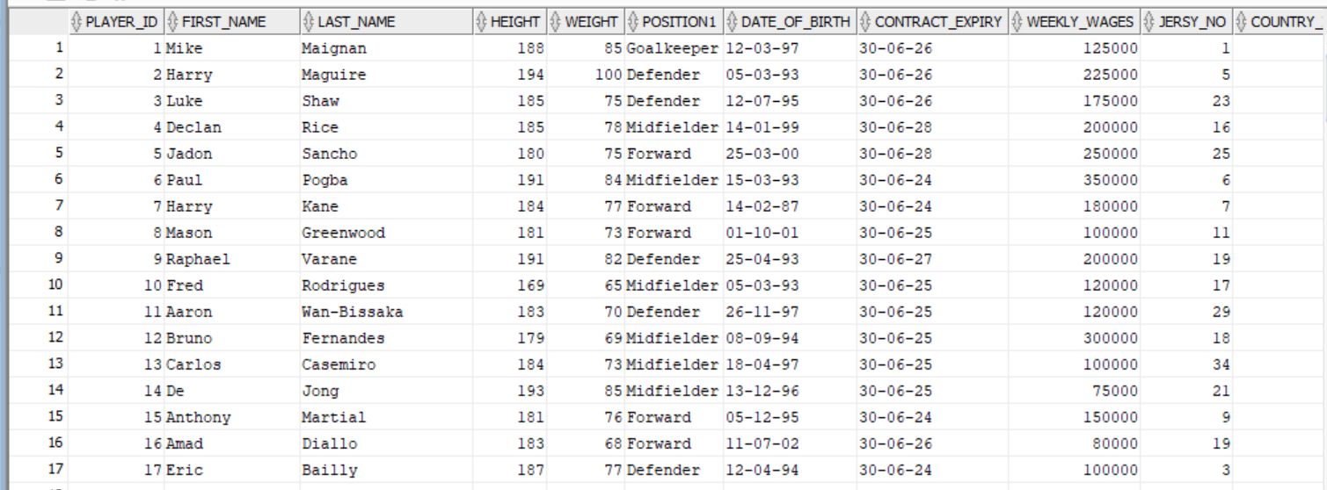
TABLES:
Player:

Slide 16
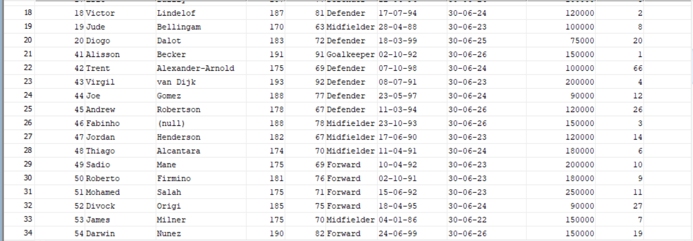
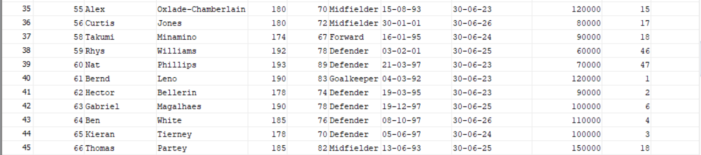

Slide 17
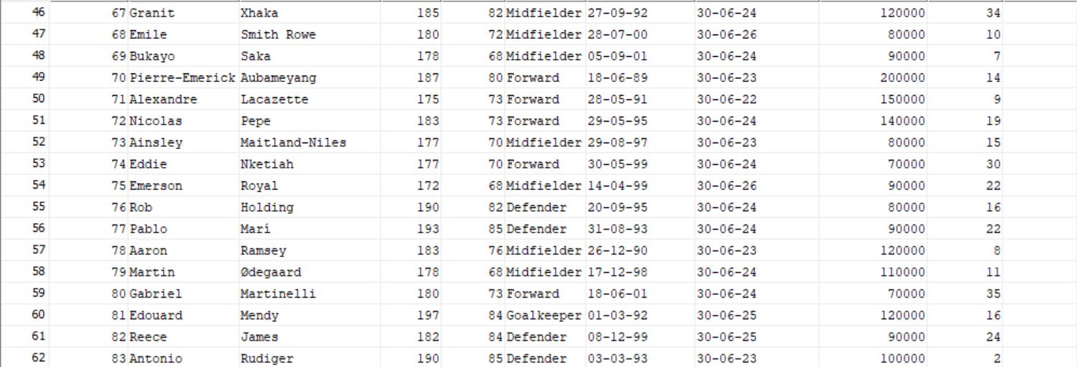
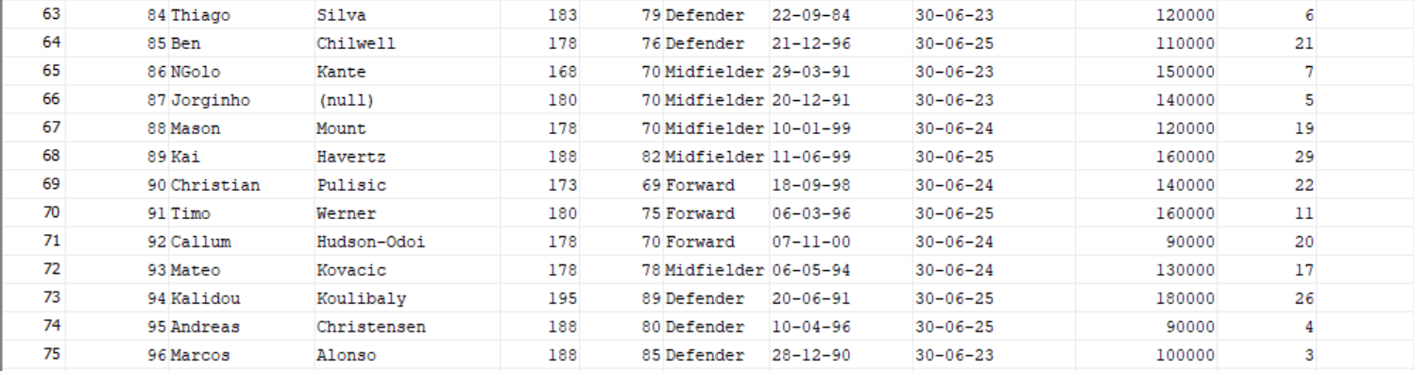

Slide 18
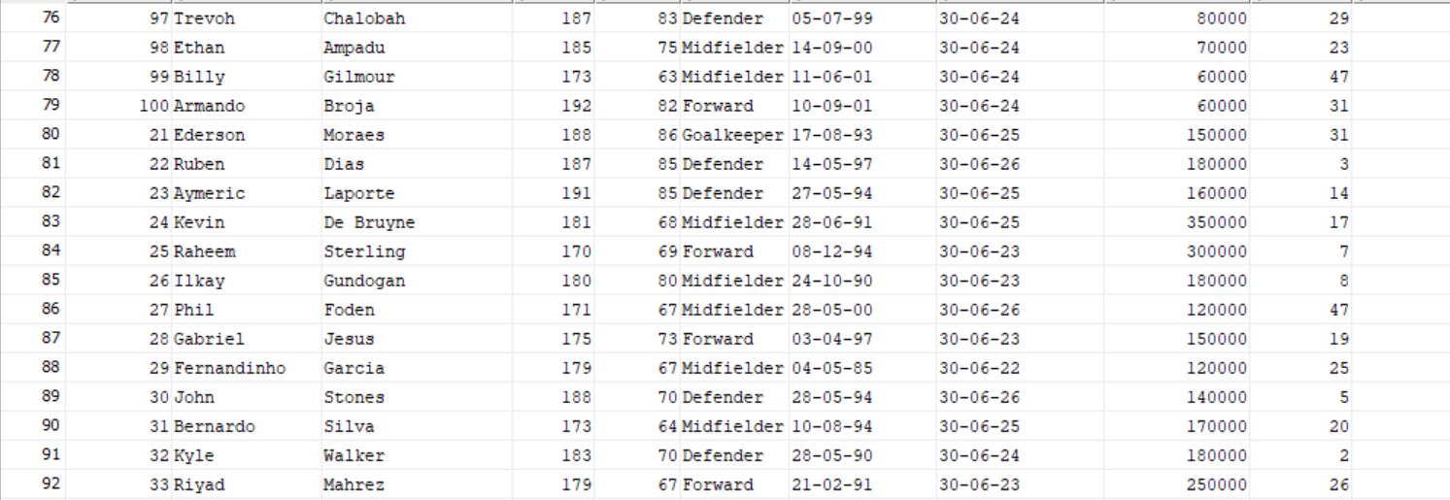
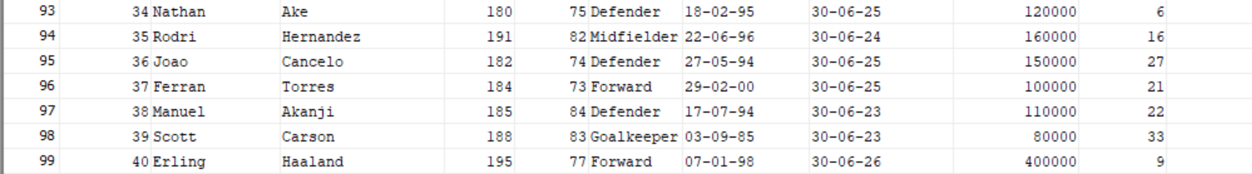

Slide 19
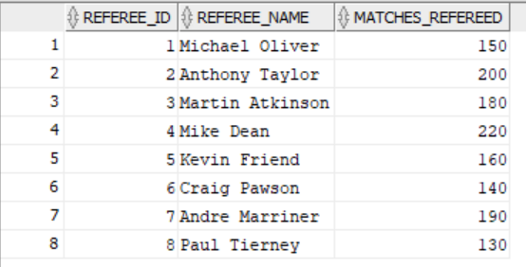
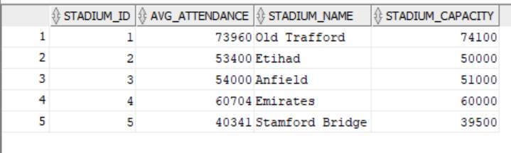
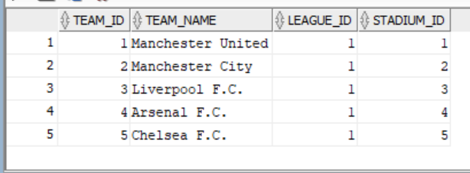
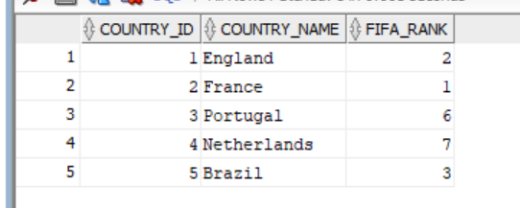
Stadium: Referee:
Club:
country:

Slide 20
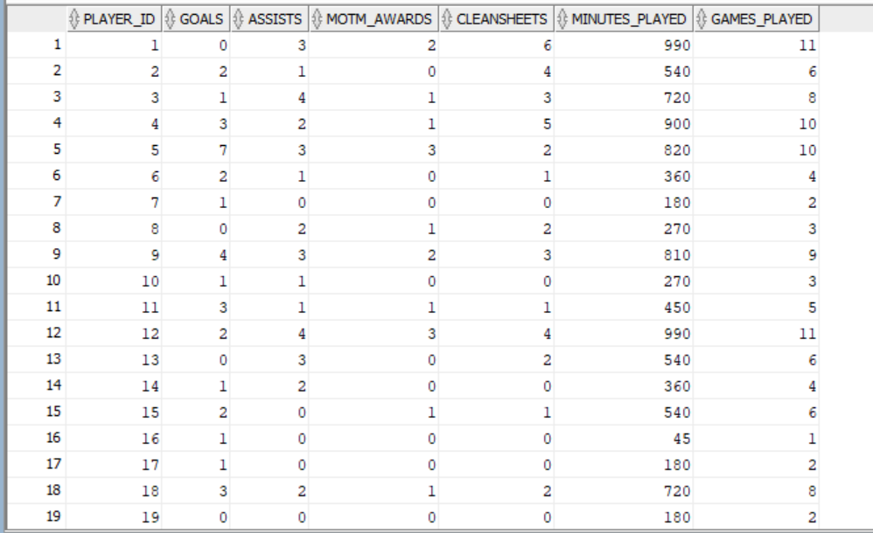
Stats:

Slide 21
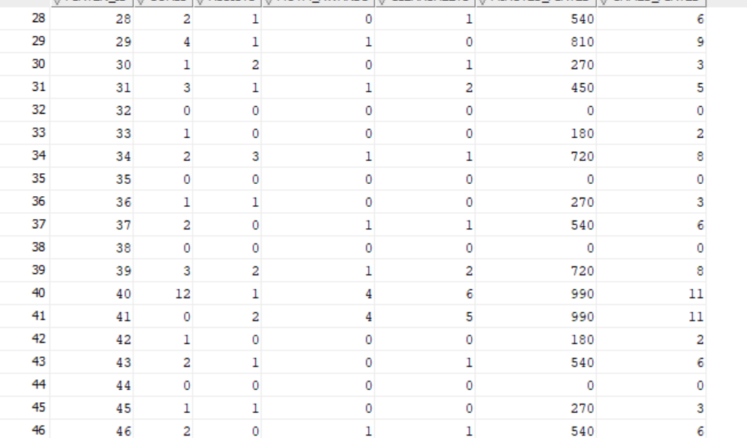

Slide 22
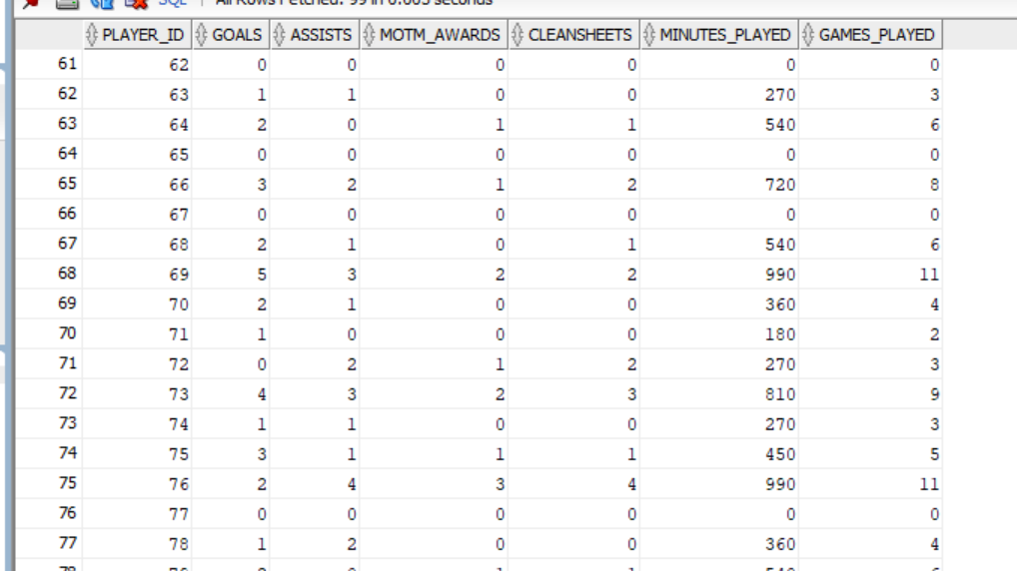

Slide 23
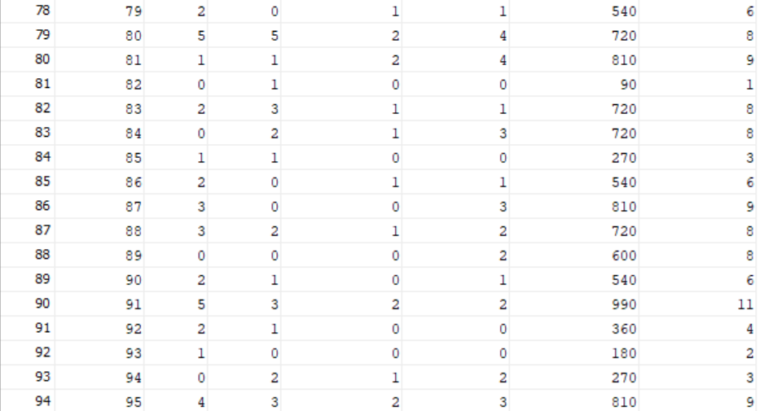
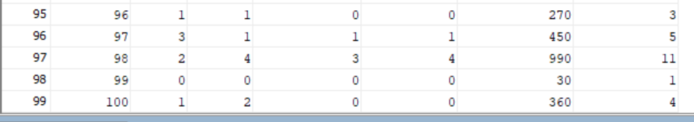

Slide 24
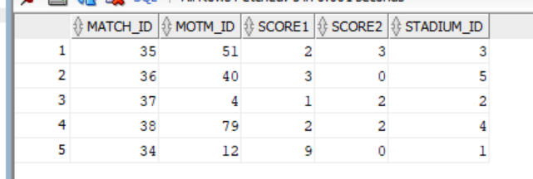
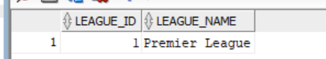
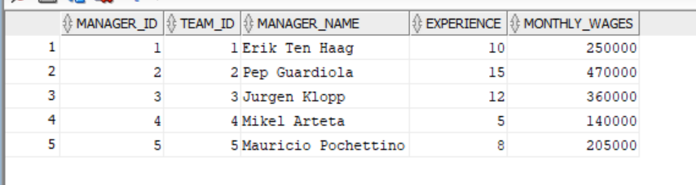
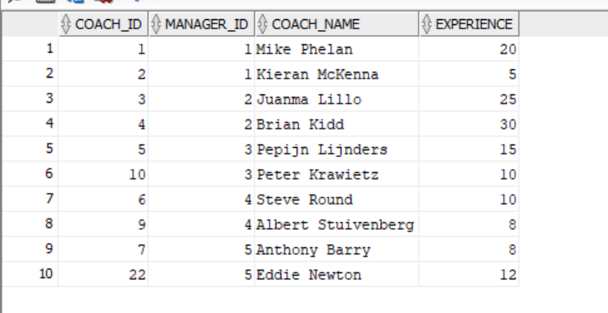
Matches: League:
Managers: Coaches:

Slide 25
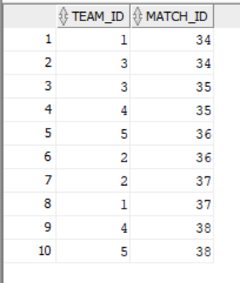
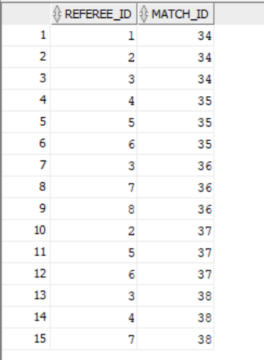
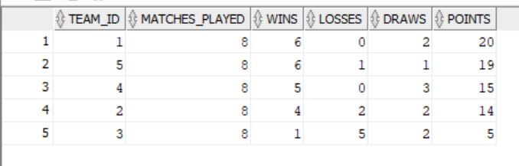
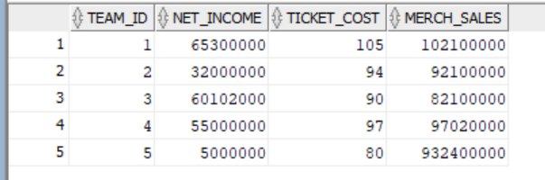
Points_table: Club- Match: Match-referee:
Revenue:

Slide 26
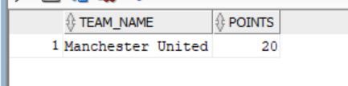
Queries:-
Write a sql query to know winner of the league?
Sol.
select team_name,points from club c,points_table p where c.team_id = p.team_id and c.team_id=(select team_id from points_table where points=(select max(points) from points_table));

Slide 27
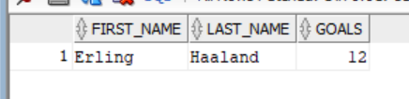
2. Write an SQL query to show the league’s top goalscorer.
Sol.
select first_name,last_name,goals from player p,stats s where p.player_id=s.player_id and p.player_id= (select player_id from stats where goals=(select max(goals) from stats));

Slide 28
3. Write an SQL trigger to update the points_table when a new row is inserted into matching table.
Sol.
set serveroutput on;
create or replace trigger update_table after insert on matching for each row
declare
points_change int;
begin
if :new.score1> :new.score2 then points_change:=3;
elsif :new.score1= :new.score2 then points_change:=0;
else points_change:=-3;
end if;

Slide 29
update points_table
set matches_played= matches_played+1,
wins = wins + CASE WHEN points_change = 3 THEN 1 ELSE 0 END,
losses = losses + CASE WHEN points_change = -3 THEN 1 ELSE 0 END,
draws = draws + CASE WHEN points_change = 0 THEN 1 ELSE 0 END,
points = points + CASE WHEN points_change = 3 THEN 3 ELSIF 0 THEN 1 ELSE 0 END,
where team_id= (select team_id from club_match where match_id = :new.match_id and team_id = (select team_id from club where stadium_id=:new.stadium_id));
update points_table
set matches_played= matches_played+1,
wins = wins + CASE WHEN points_change = -3 THEN 1 ELSE 0 END,
losses = losses + CASE WHEN points_change = 3 THEN 1 ELSE 0 END,
draws = draws + CASE WHEN change = 0 THEN 1 ELSE 0 END,
points = points + CASE WHEN points_change = -3 THEN 3 ELSIF 0 THEN 1 ELSE 0 END,
where team_id= (select team_id from club_match where match_id = :new.match_id and team_id not in (select team_id from club where stadium_id=:new.stadium_id));
end;
/

Slide 30
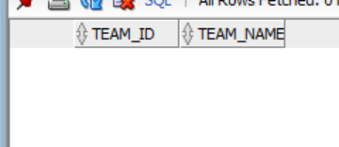
4. Write a sql query to show a team that has not won any matches.
Sol.
SELECT t.team_id, t.team_name
FROM club t
JOIN points_table p ON t.team_id = p.team_id
WHERE p.wins IS NULL;

Slide 31
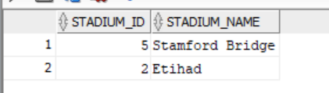
5. Write an sql query to find the stadiums where a specific team played.
Sol.
SELECT s.stadium_id, s.stadium_name
FROM stadium s, matching m WHERE s.stadium_id = m.stadium_id and m.match_id in (SELECT match_id FROM club_match WHERE team_id=&team_id);
Input is 2

Slide 32
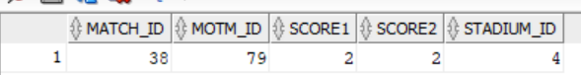
6. Write an SQL query to show the matches which ended as draw.
Sol.
SELECT * FROM matching WHERE score1 = score2 ;

